Slide 1
COMPUTER-AIDED DESIGN AND DRAFTING
NAME: IFTEKHAR, KH. TANVEER
ID: 18-39133-3
SEC: A
NAME: KHAN, SUNITY
ID: 17-35456-3
SEC: A

Slide 2
INTRODUCTION
Computer-aided design and drafting (CADD) refers to creating designs and schematics in a software environment used to manufacture products. It is, by no means, a new technology. Digitalized design and drafting for production has increased productivity in design compared to drafting with paper and a pencil.

Slide 3
purpose of AutoCAD
AutoCAD is used to create the computer aided designs or software applications including drafting
AutoCAD develops the application in both the 2D and 3D formats and provide the information to the application
AutoCAD provides tools to design the software's used in the industry, architectures and project management

Slide 4
TOOLS OF AUTOCAD
Various components of the basic AutoCAD screen are the menu bar, drawing area, several toolbars, command window, model and layout tabs and status bar. The title bar has an AutoCAD symbol, and the current drawing name is displayed on top of the screen.
Line
Circle
Rectangle
Polyline
Trim
Extend
Copy
Mirror
Rotate
Erase
Offset
Move
Array
Scale
Fillet
Explode

Slide 5
IMPORTANCE
A Streamlined Design Process
Better Quality Design
Simplify Communication
Plenty of Documentation
A Manufacturing Database
Design Data Saved

Slide 6
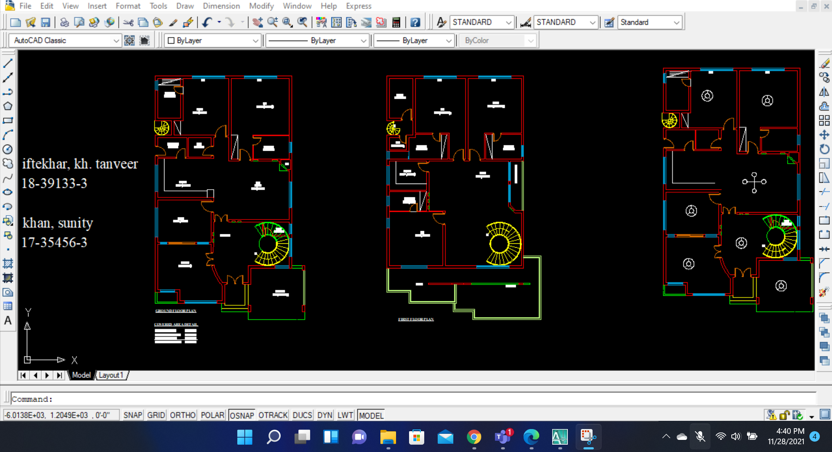
ASSIGNMENT on civil plan

Slide 7
Details of civil plan
It is the civil-plan of duplex home. Total plot area is about 4500 square ft. Ground floor area covered more than the first floor area. The ground floor area is 3094 square ft and first floor area is about 2783 square ft. After all the total covered area of ground and first floor is about 5877 square ft.

Slide 8
Details of civil plan
In this duplex home there is two master bed room and four bedroom as well. Here we can find some washrooms and kitchen. Dining , drawing , sitting area and tv lounge included in this duplex civil plan. There is also a car parking area. We have also balcony in this home.

Slide 9
Thank You

